Slide 1
48v to Cryo Board Cable

Slide 2
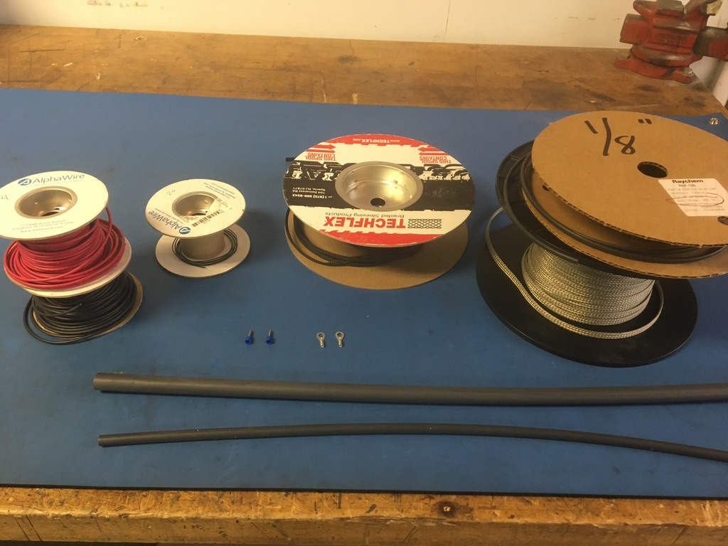
Materials

Slide 3
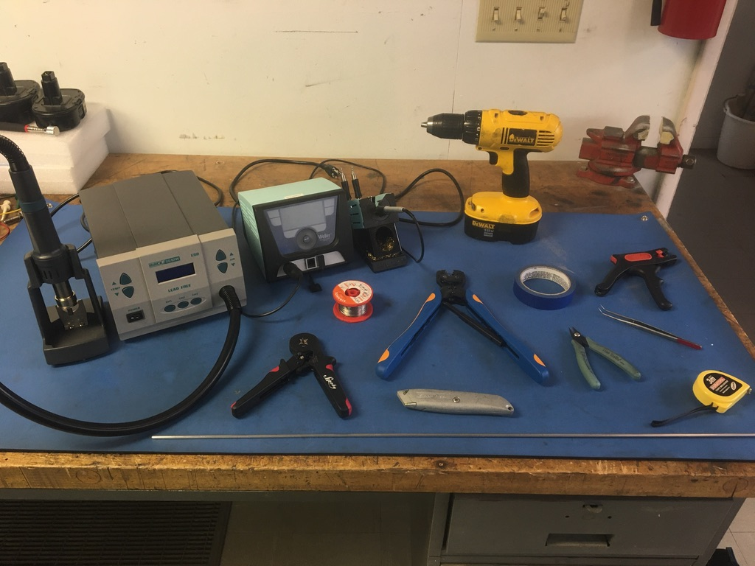
Tools

Slide 4
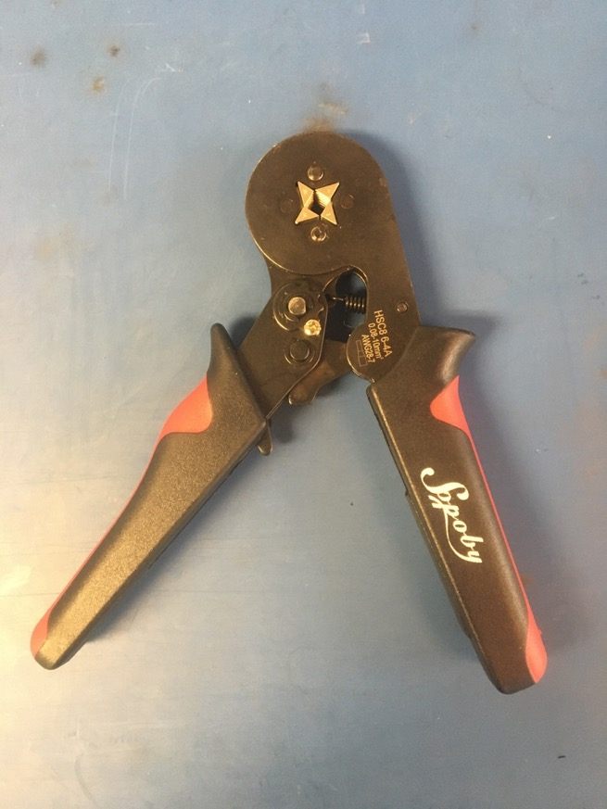
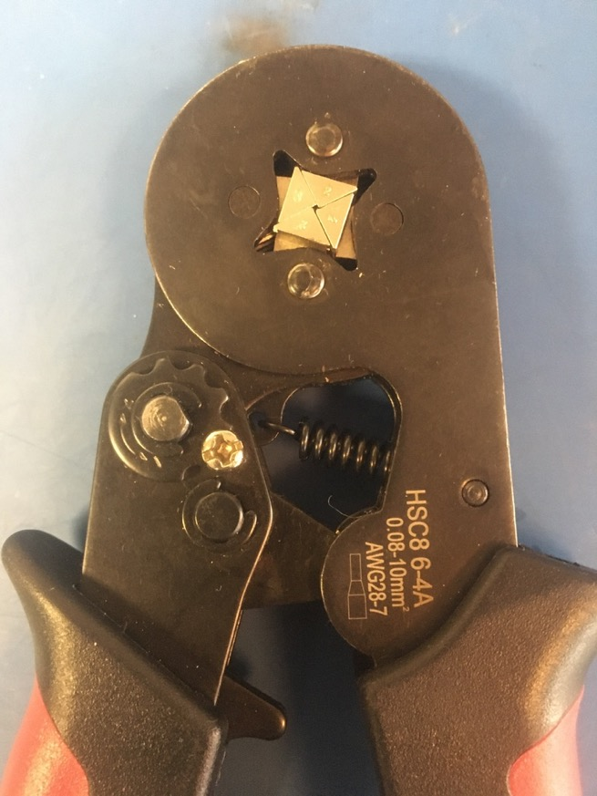
Ferrule Crimper

Slide 5
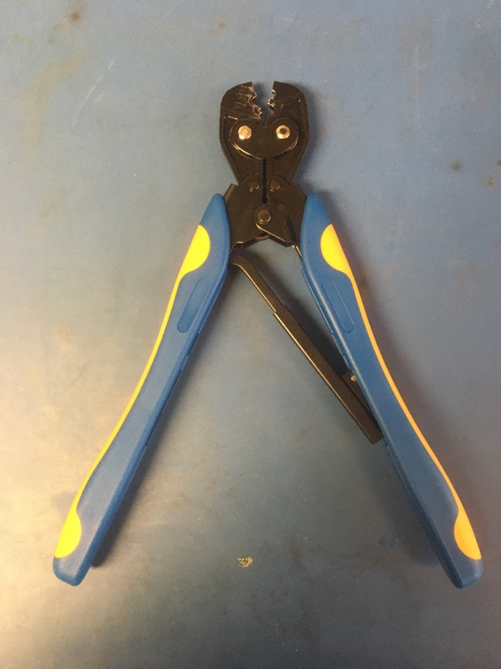
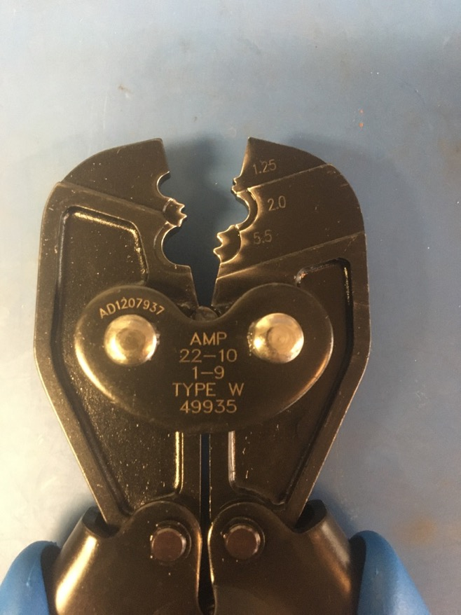
Eye Crimper

Slide 6
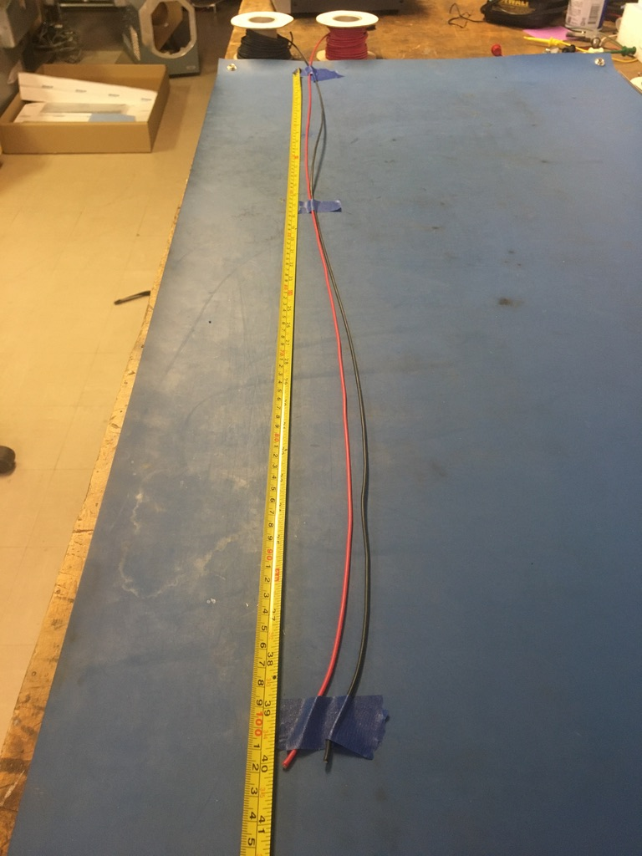
Measure out and cut 40 inches of red and black 14 awg wire.

Slide 7
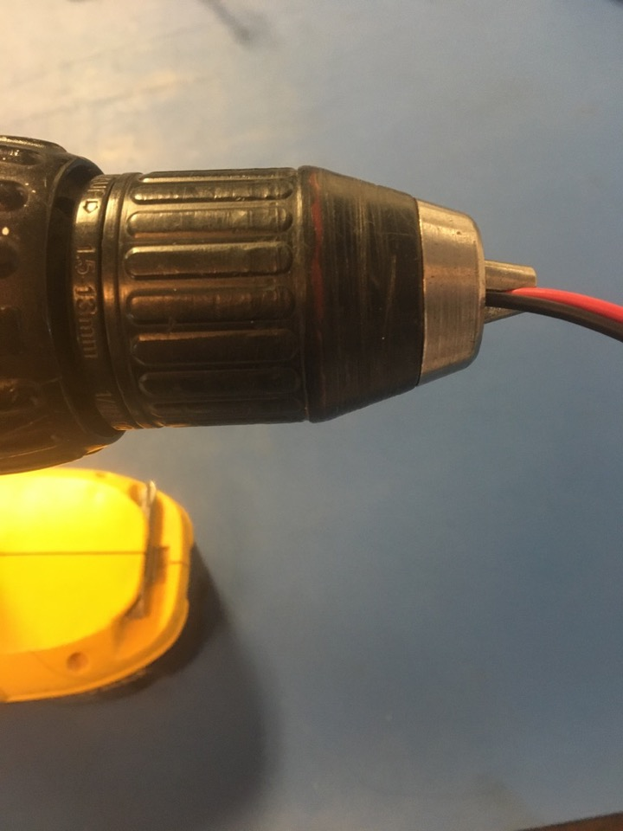
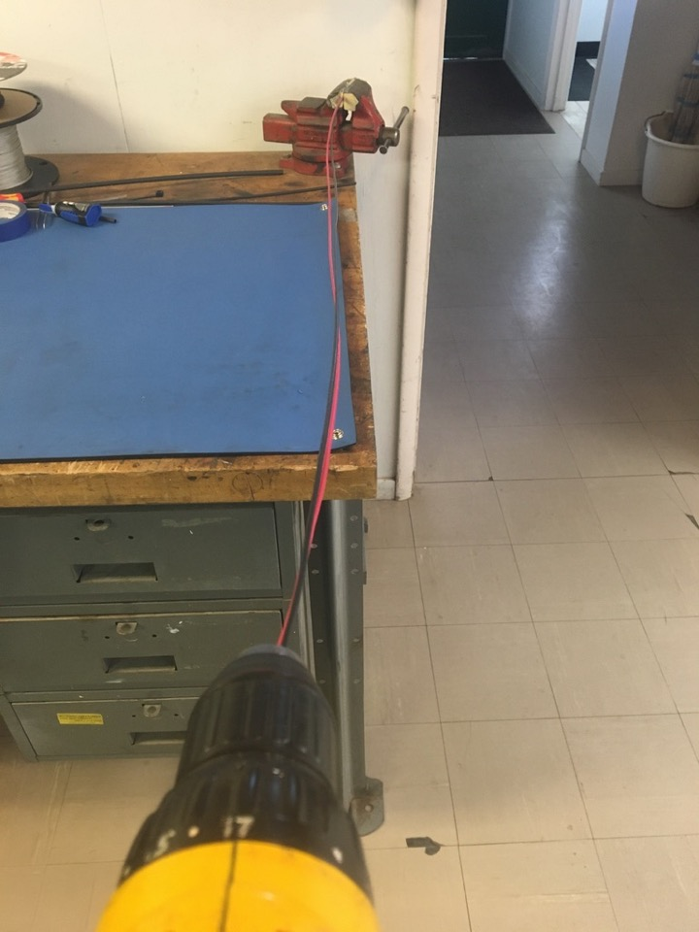
To make the twisted pair, line the vise with masking tape. Put one end of the red and black wires that were just cut into the vise and the other into the drill. Run the drill till the wires are sufficiently twisted (for reference see the next slide).

Slide 8
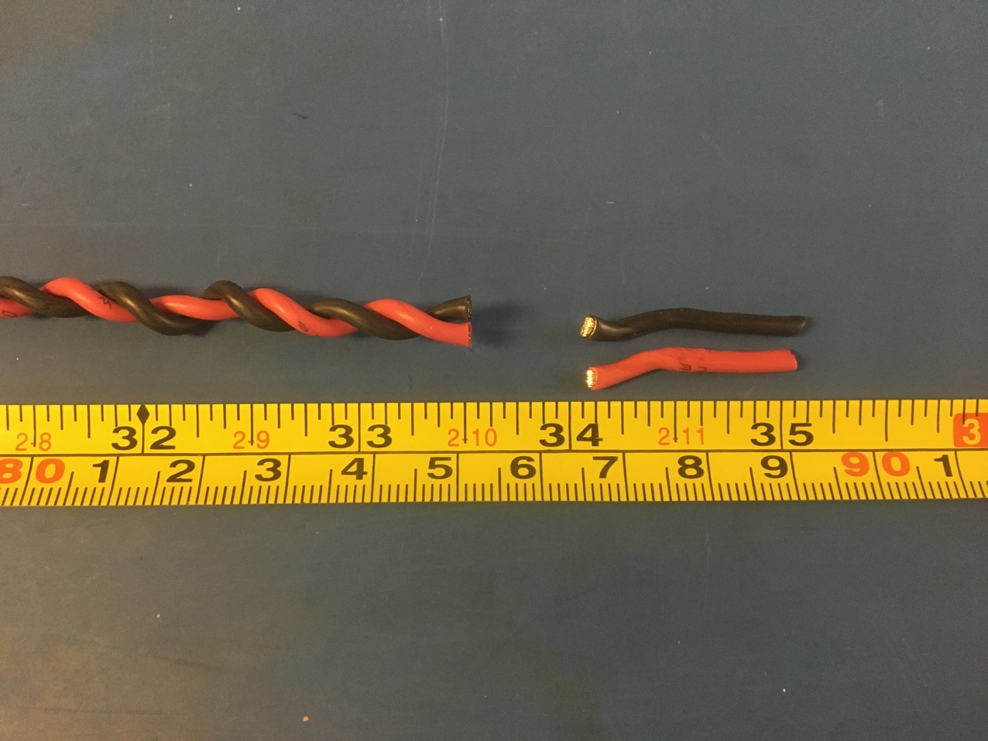
Trim the ends of the twist pair where they were in the vise and drill. Once trimmed it should measure about 33.5 inches.

Slide 9
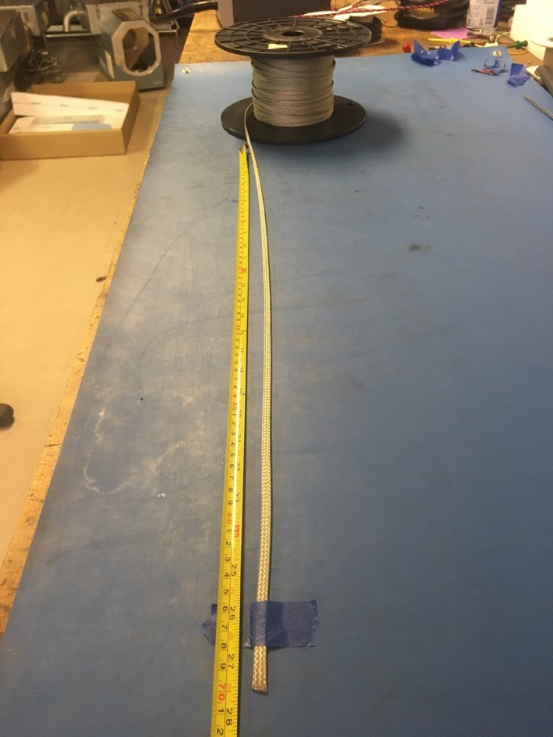
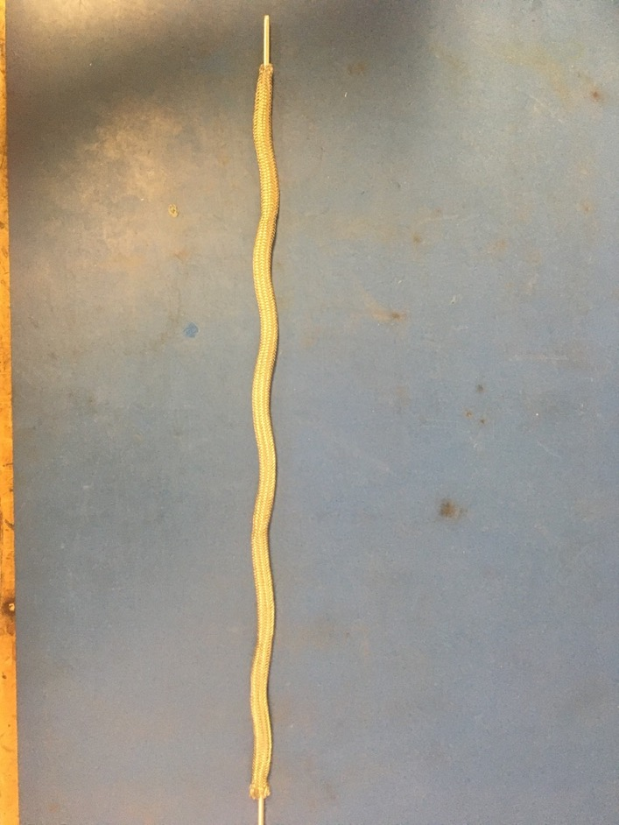
Measure out 27.5 inches of the .203 metal braid. Expand it using the metal rod.

Slide 10
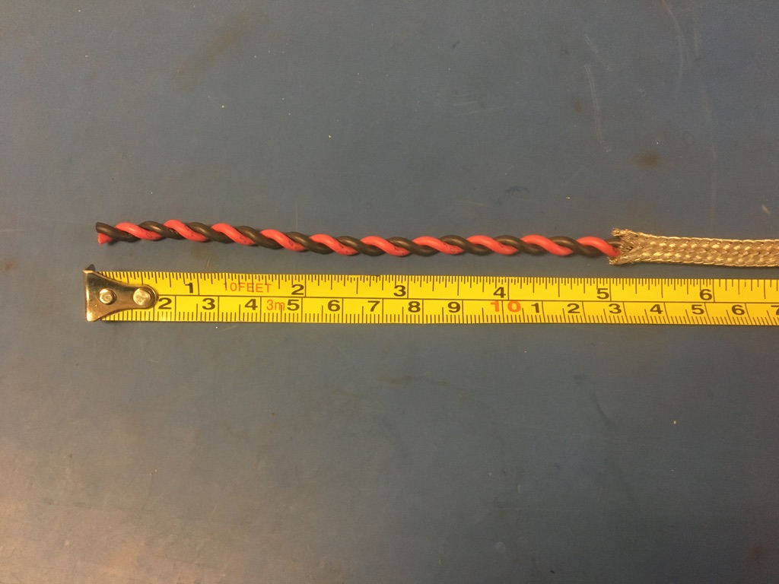
Put the twisted pair into the expanded metal braid. 5 inches of the twisted wires should stick out from the metal braid on one end.

Slide 11
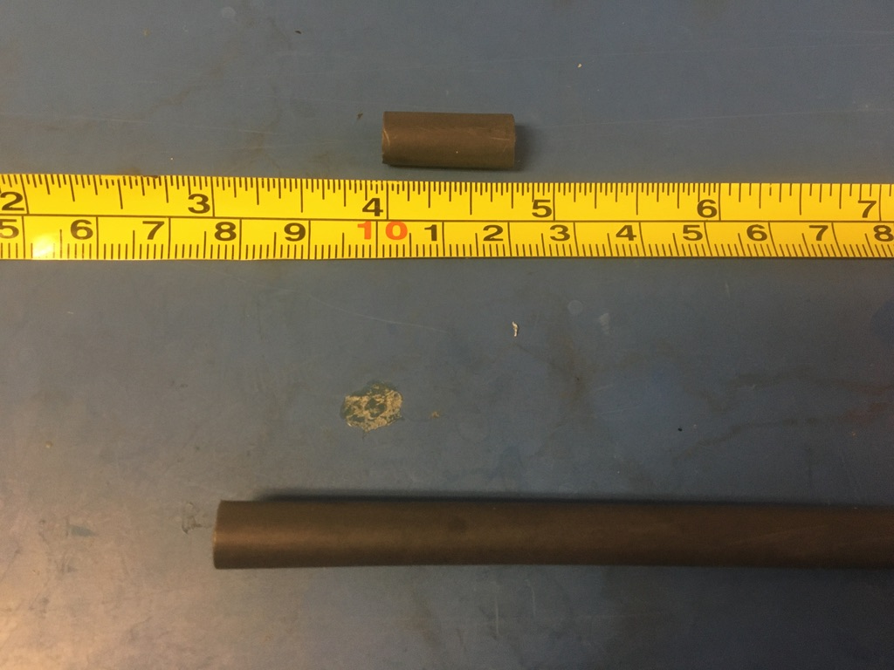
Measure out and cut two lengths of 6.4mm adhesive shrink tube each .75in long.

Slide 12
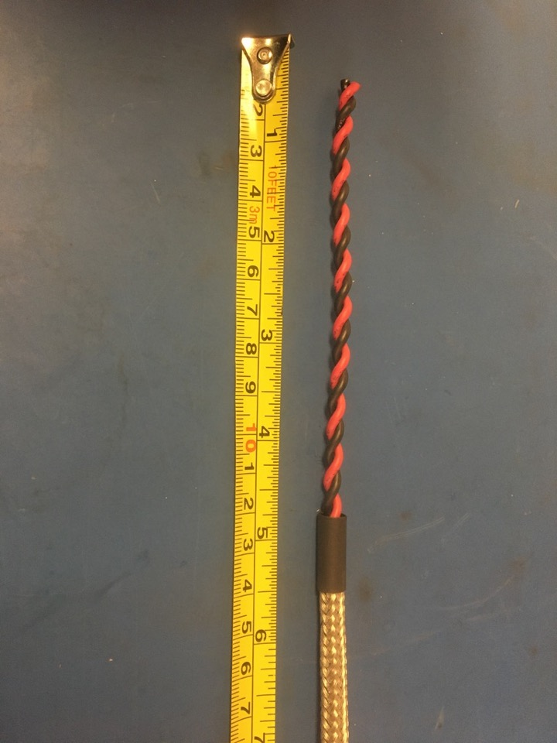
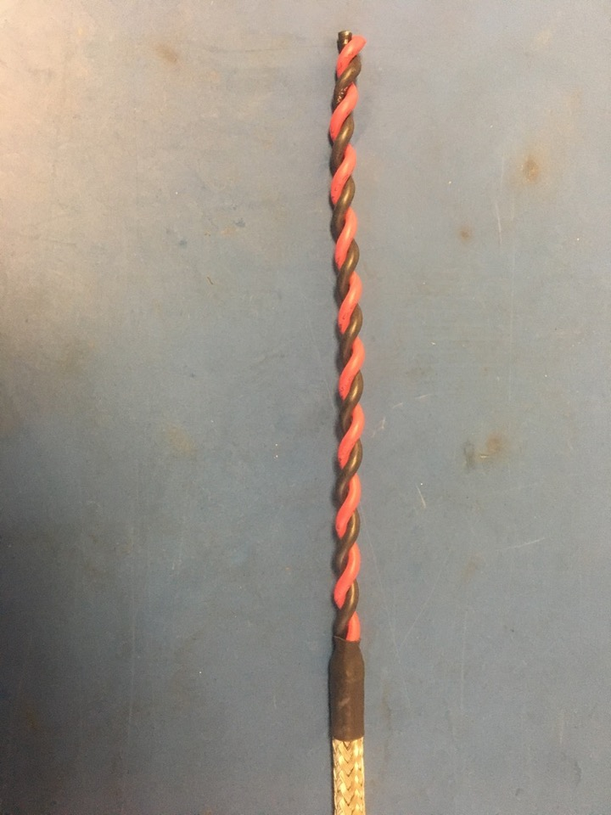
Put one of the pieces of the shrink tube onto the end of the metal braid where the wires sticking out measured 5 inches. Place the shrink tube such that the metal braid ends midway through it. The wires should now measure 4.75 inches long. Apply the heat gun to the shrink tube.

Slide 13
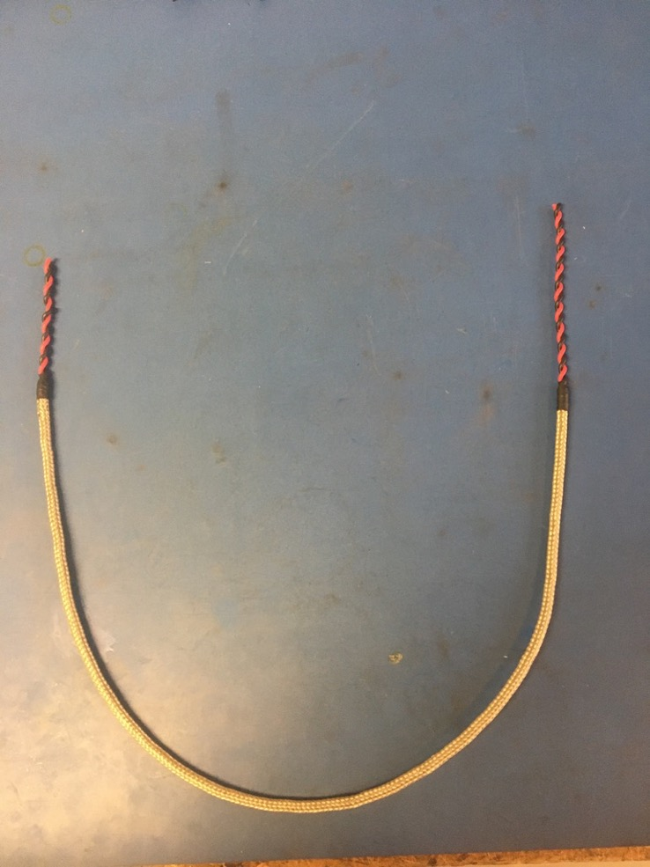
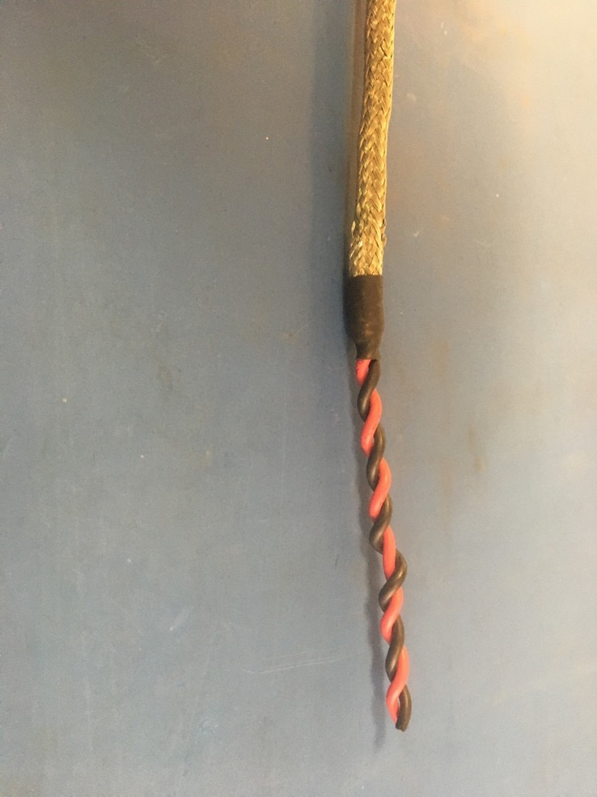
Repeat the process on the previous slide on the other end of the metal braid (though the wire does not need to be measured this time). Thus far, the wire harness should appear as shown on the right.

Slide 14
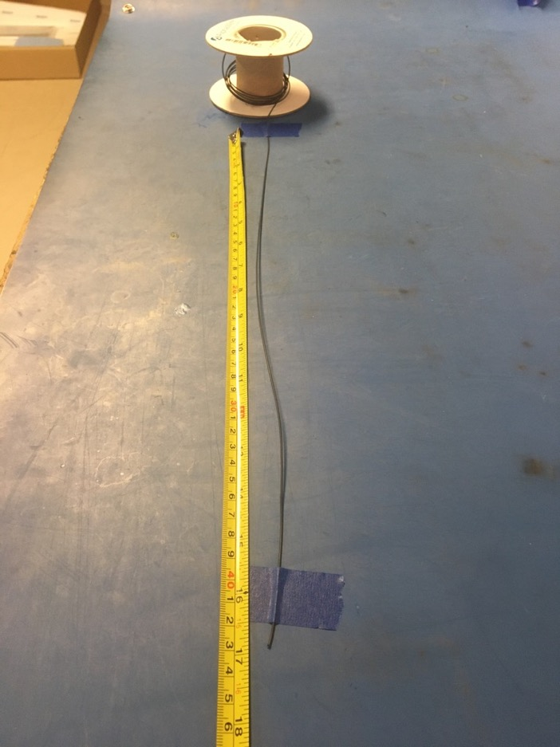
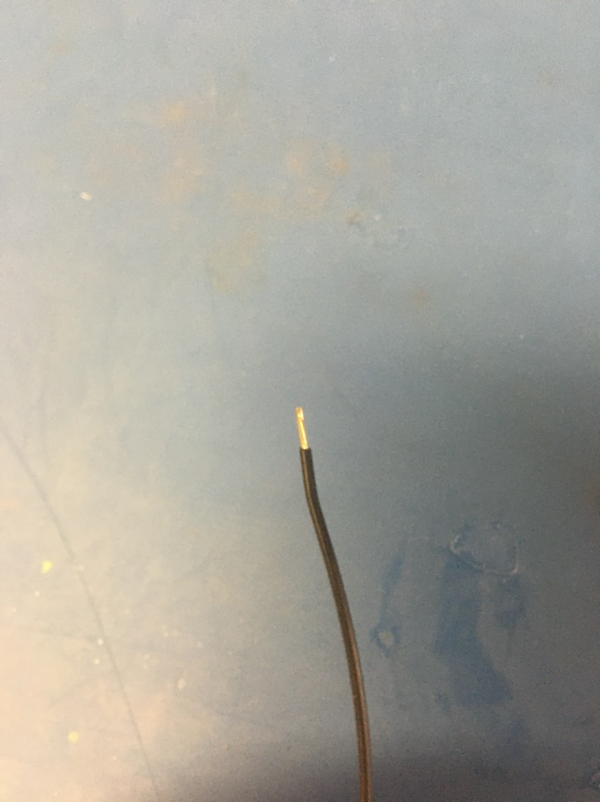
Measure out and cut 17 inches of black 24 awg wire. Strip 3-4mm of one end.

Slide 15
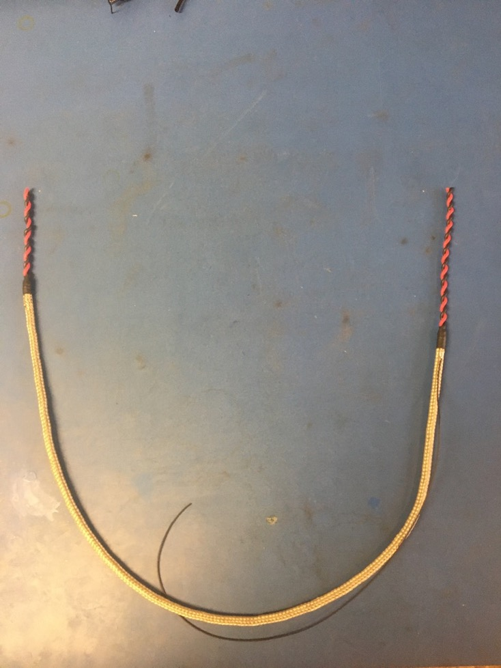
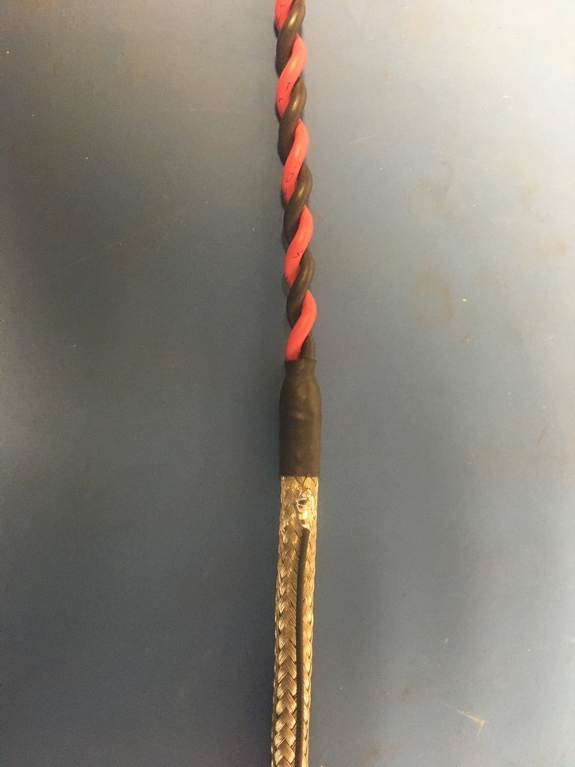
Solder the stripped end of the black wire onto the metal braid near the shrink tube joint with the longer length of wire (measured to be 4.75 inches previously). The black wire should be soldered so the that its length runs with that of the metal braid.

Slide 16
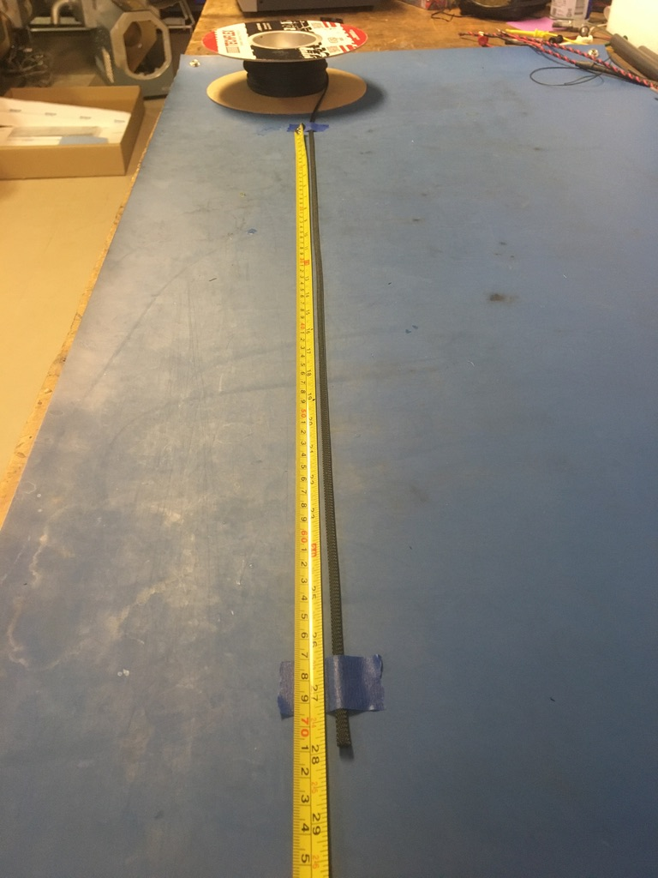
Measure out and cut 28 inches of 1/4th plastic braid.

Slide 17
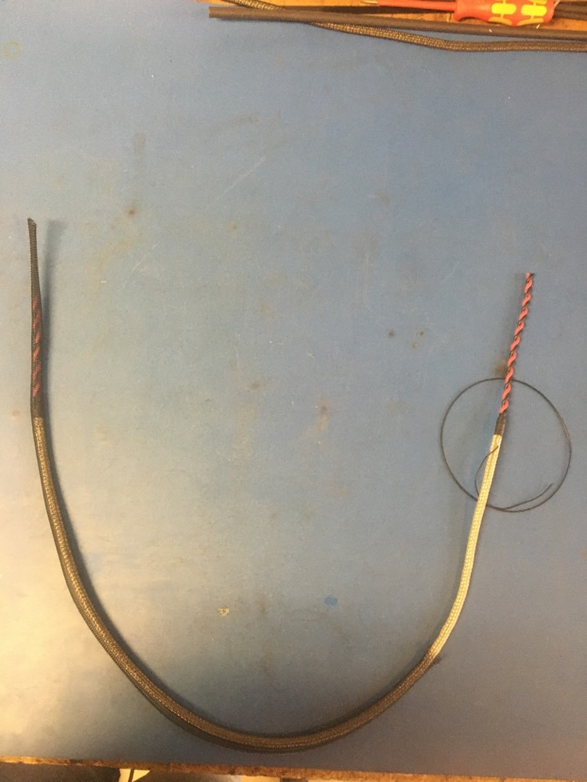
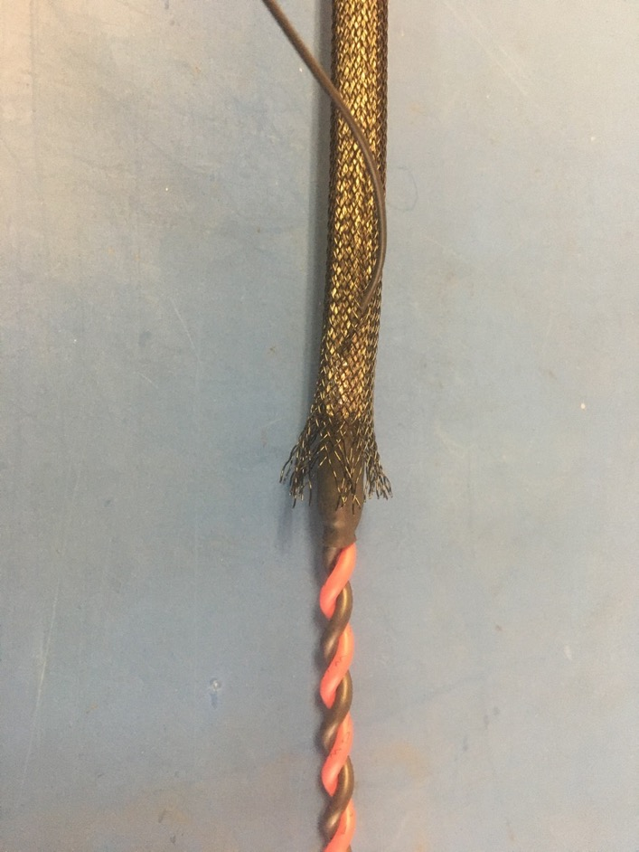
Put the plastic braid onto the wire harness. It does not matter from which end. Thread the ground wire through one of the holes in the plastic braid so it appears as shown on the right. The plastic braid should end midway through the metal shrink tube joint underneath it.

Slide 18
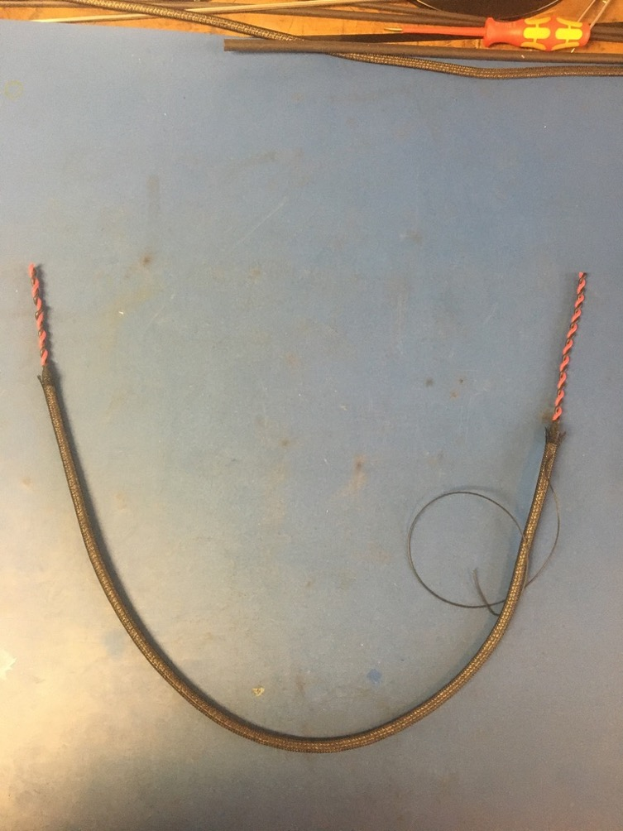
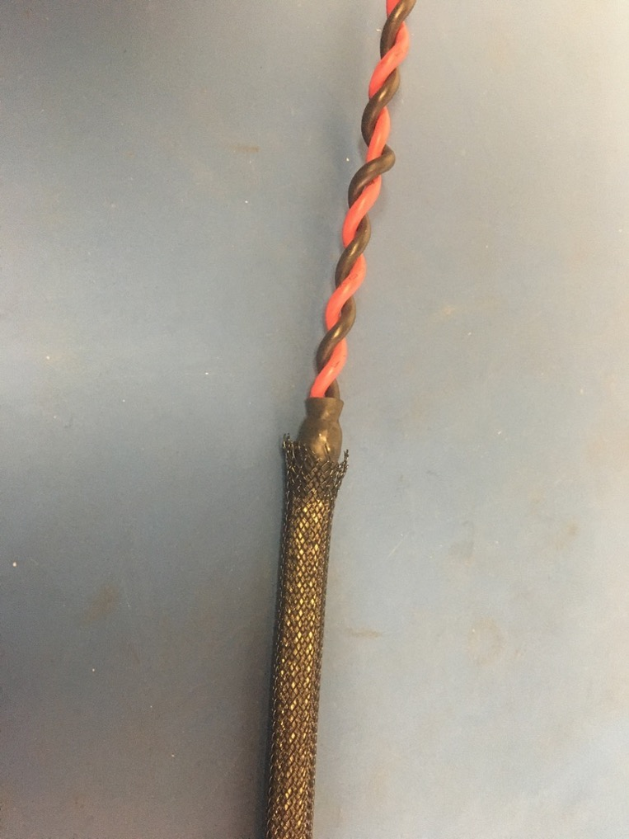
The plastic braid should end midway through the metal braid shrink tube joint on the other end of the harness as well.

Slide 19
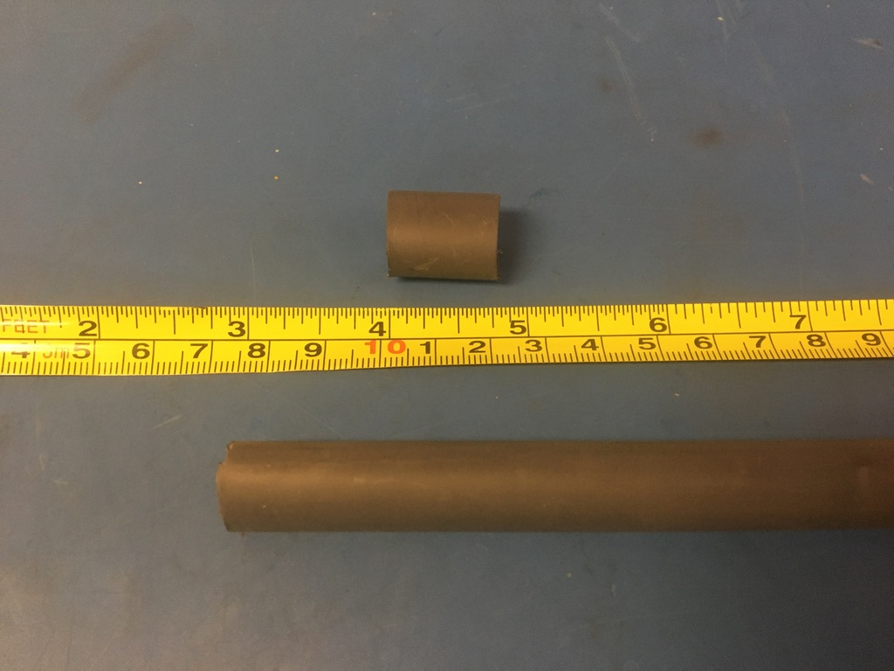
Measure out and cut one length of 12.7mm adhesive shrink tube that is .75in long.

Slide 20
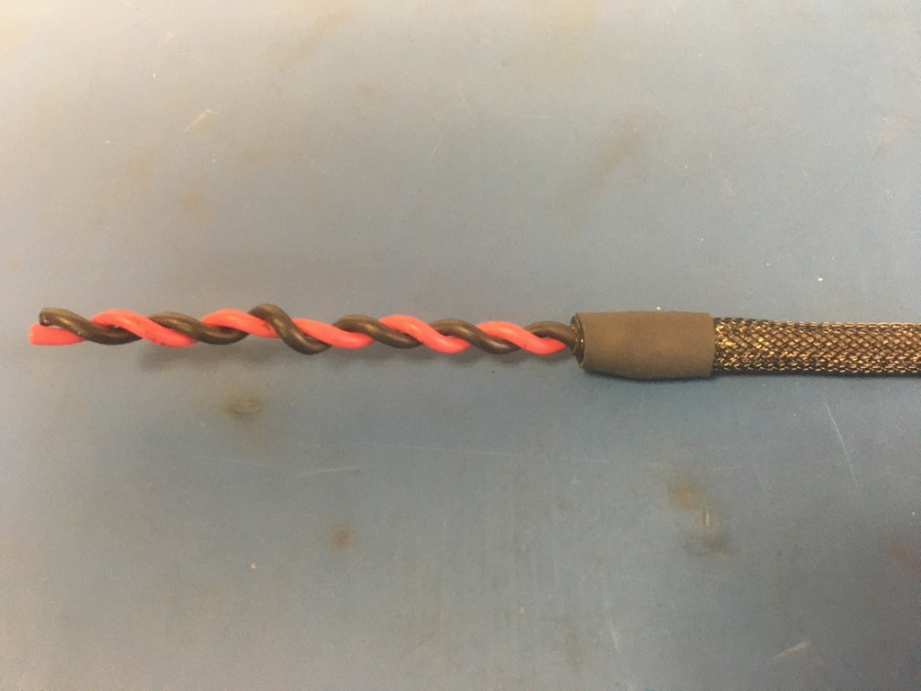
Place the piece of shrink tube onto the plastic braid end without the ground wire. The plastic braid should end midway through the piece of shrink tube. Apply the heat gun.

Slide 21
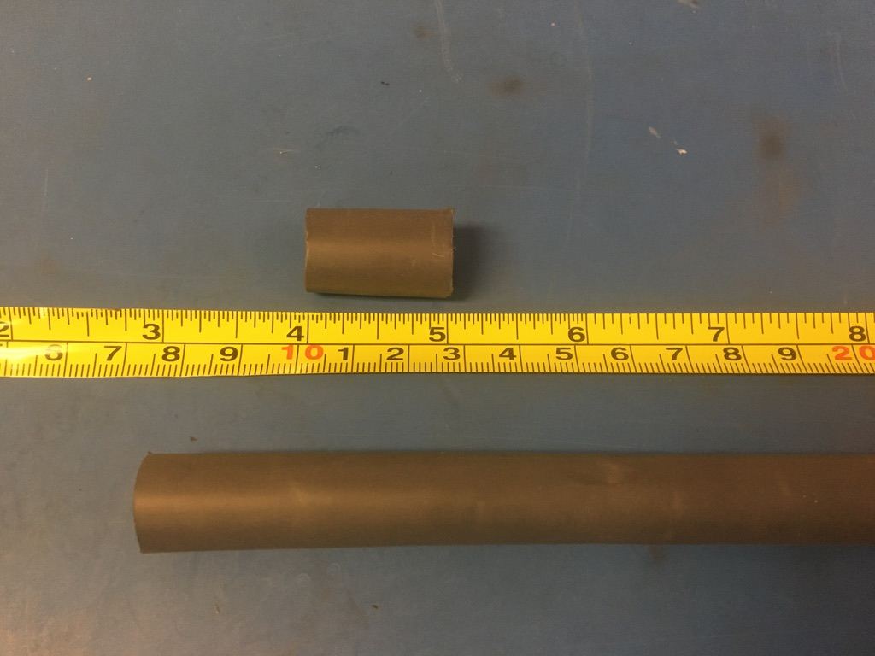
Measure out and cut one length of 12.7mm adhesive shrink tube that is 1in long.

Slide 22
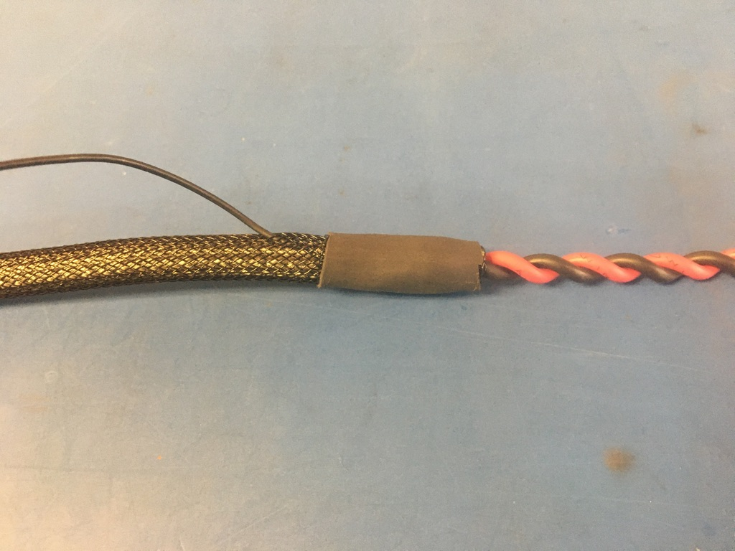
Place the piece of shrink tube onto the plastic braid end with the ground wire. The shrink tube should be placed such that it covers the solder joint and the length of shrink tube beneath. Apply the heat gun.

Slide 23
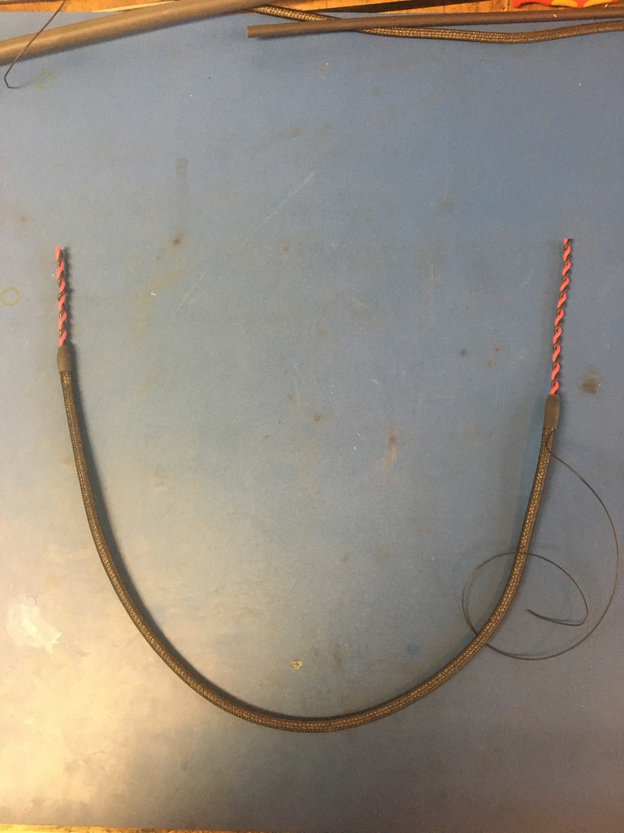
Thus far, the wire harness should look as shown.

Slide 24
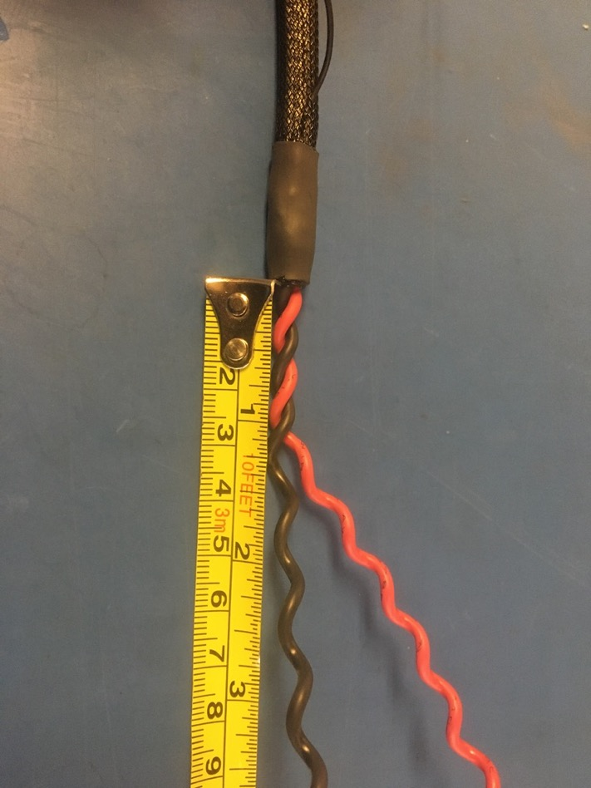
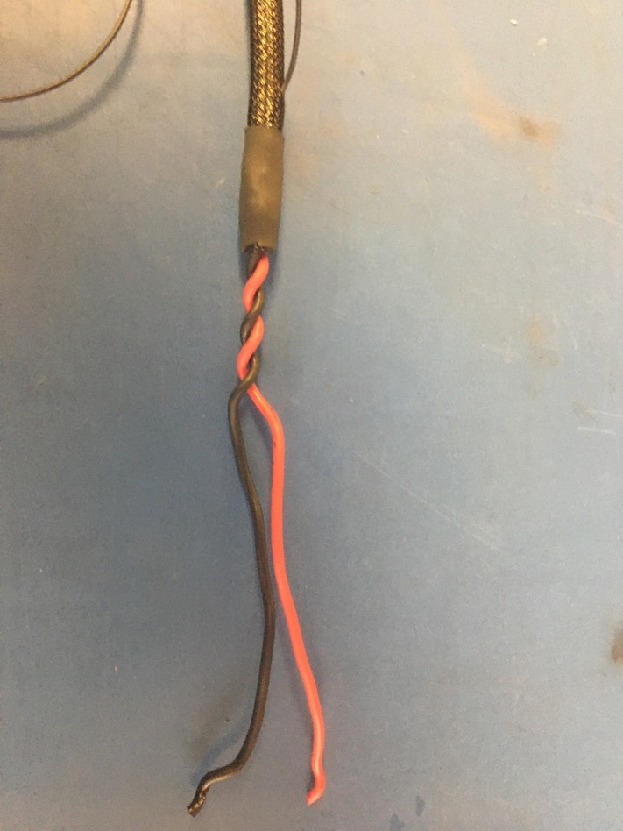
Take the ground wire end of the wire harness and untwist it until about 1in of it remains twisted. Straighten out the lengths that were untwisted.

Slide 25
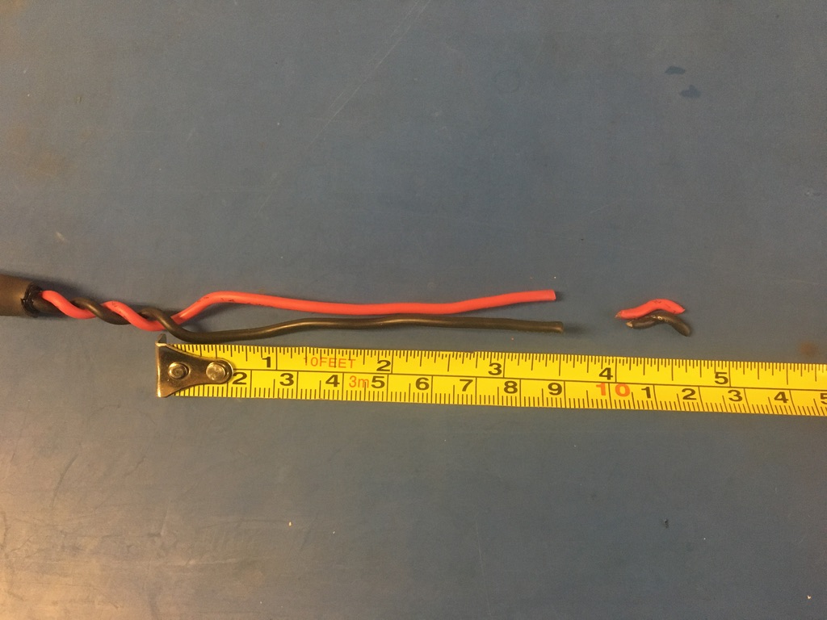
Measure the lengths of wire that were untwisted and cut them to be 3.5 inches long.

Slide 26
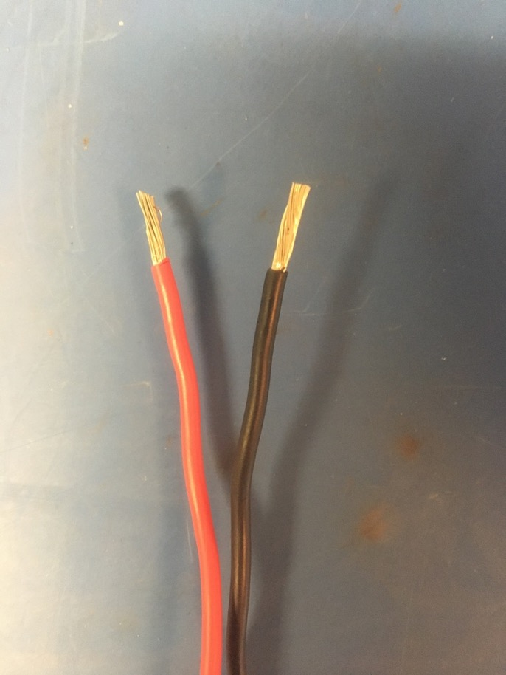
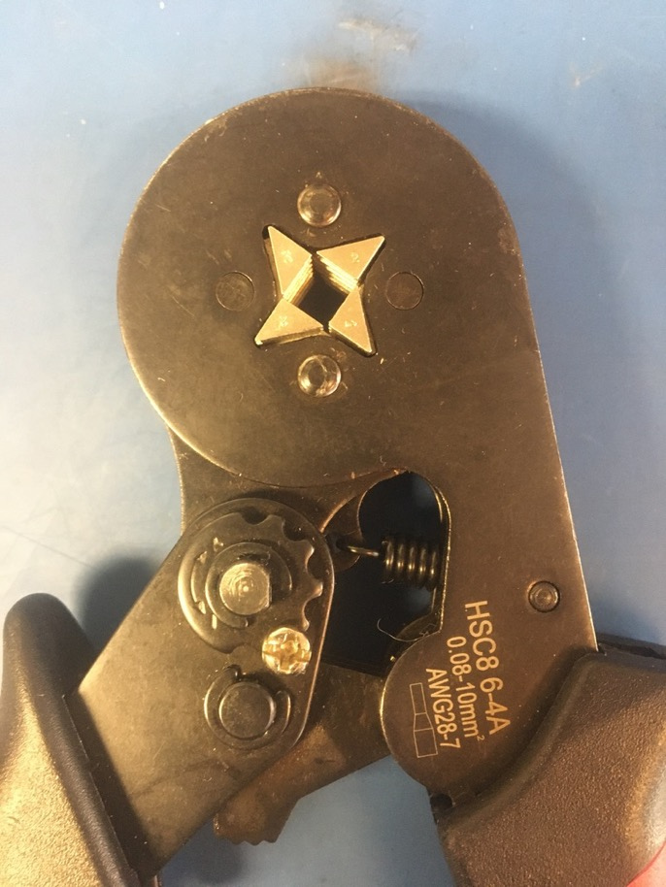
Taking the two ends of wire that were just trimmed, strip about blah mm of isolation off. Next, use the ferrule crimp tool to crimp on the ferrule tips. Be sure that the all the exposed wire will be covered by the ferrule. If the exposed wire is too long, put the ferrule as close to the isolation as possible regardless if some exposed wire pokes out the top of the ferrule.

Slide 27
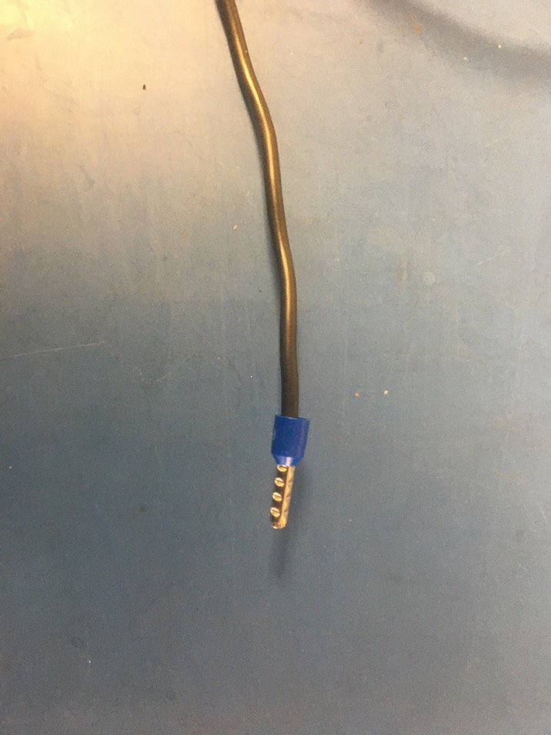
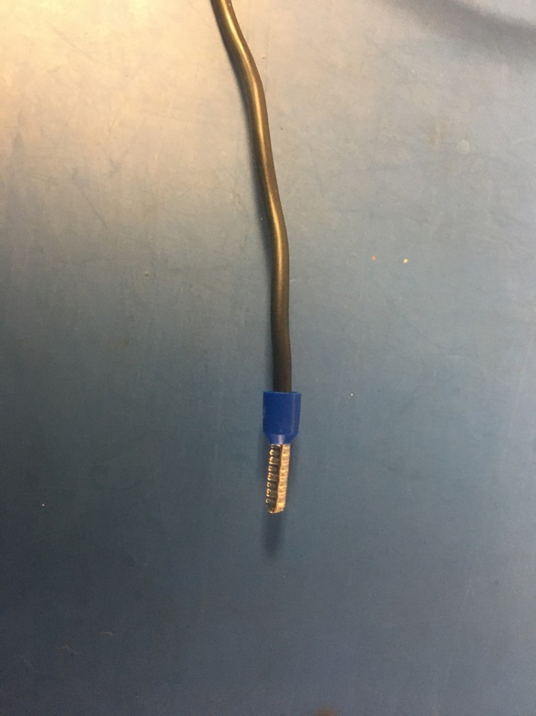
The ferrule should be crimped 2-3 times. After one crimp the ferrule should appear as shown on the left. The photo on the right shows how the ferrule should look once completely crimped.

Slide 28
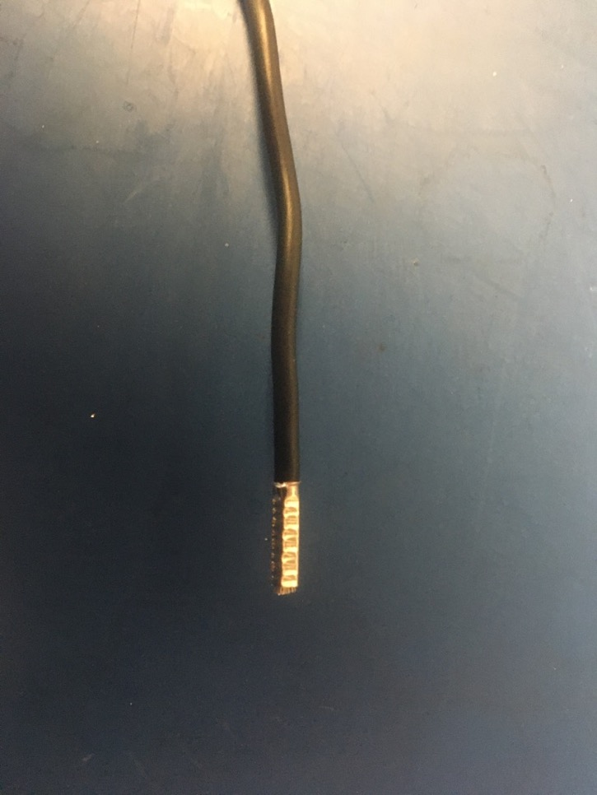
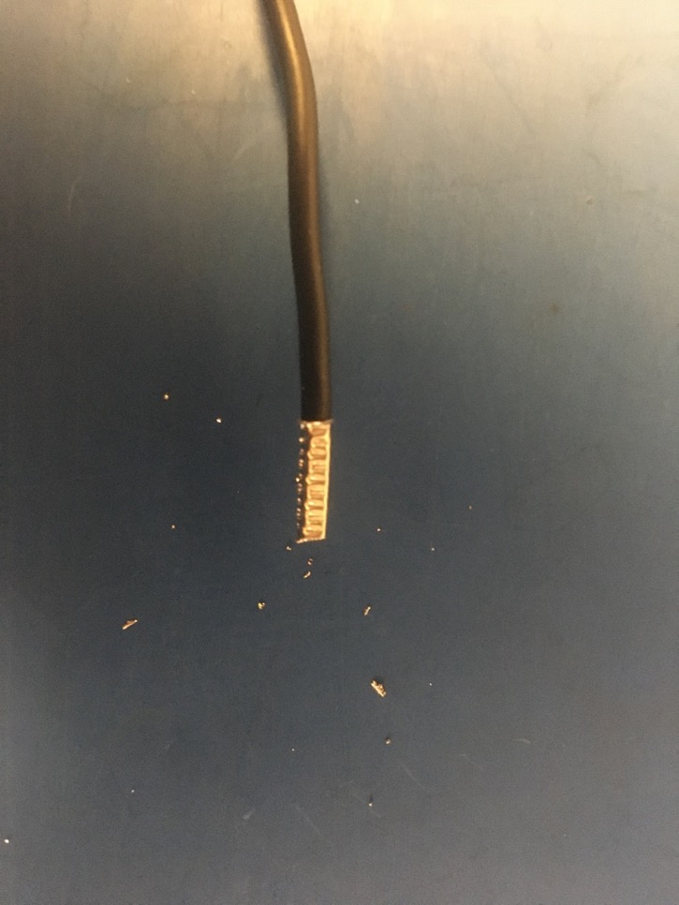
Remove the blue plastic at the bottom of the ferrule and trim any exposed wire poking out the top of the ferrule.

Slide 29
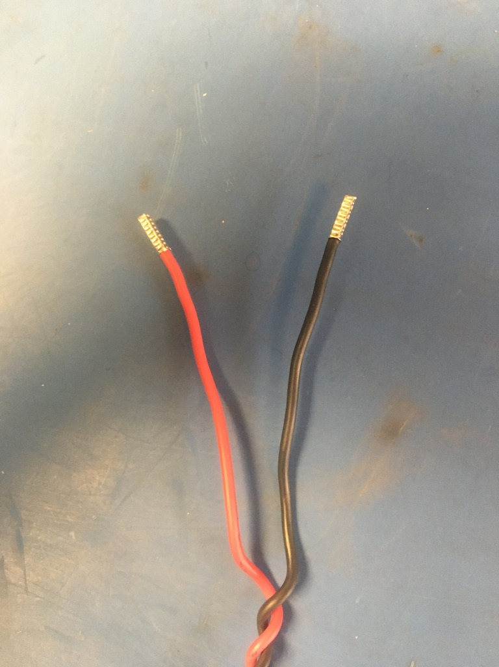
Repeat the crimping process of the ferrule on the red wire. Once complete, this is how the ground wire end of the harness should look.

Slide 30
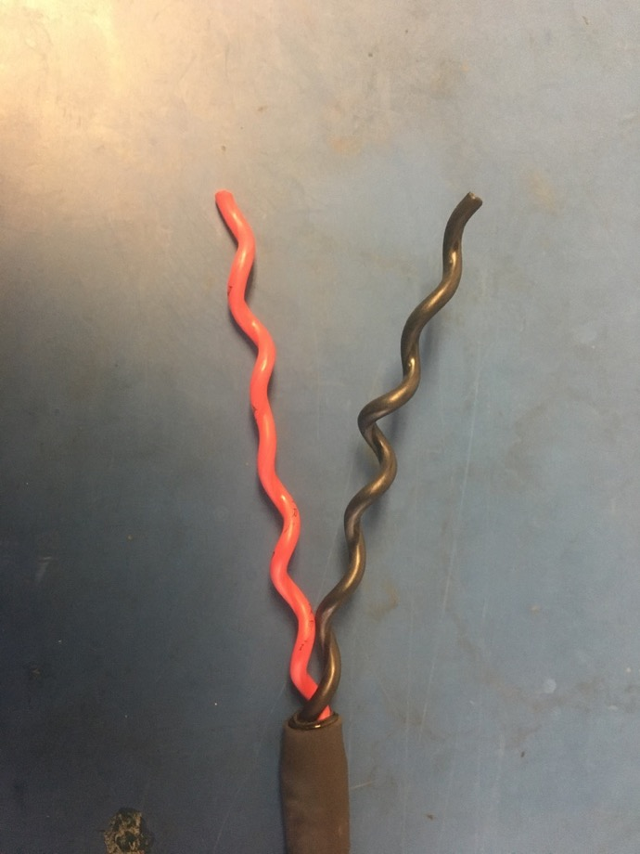
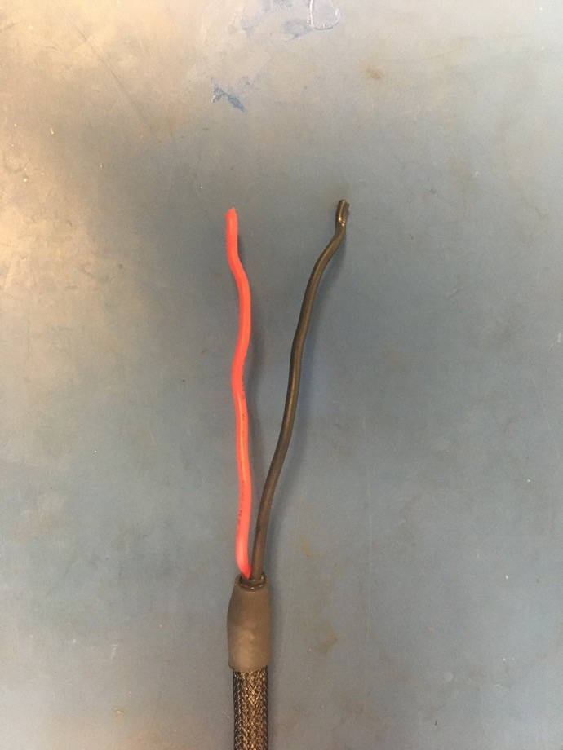
Take the other end of the wire harness and completely untwist the wires and straighten them.

Slide 31
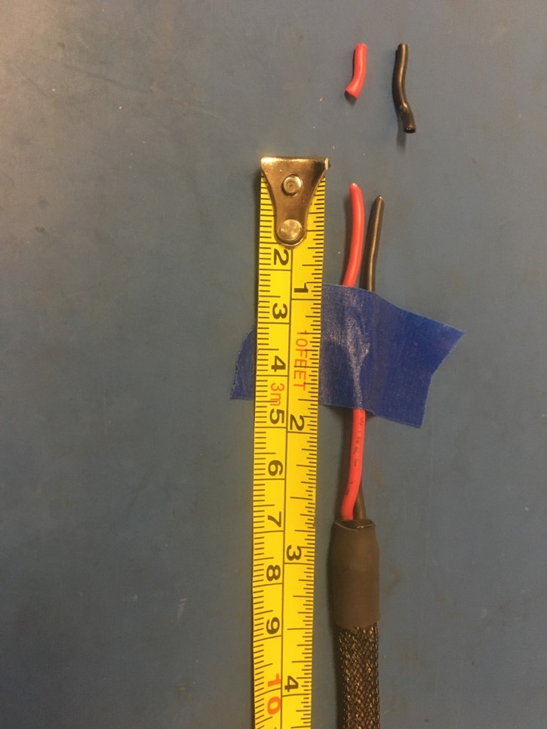
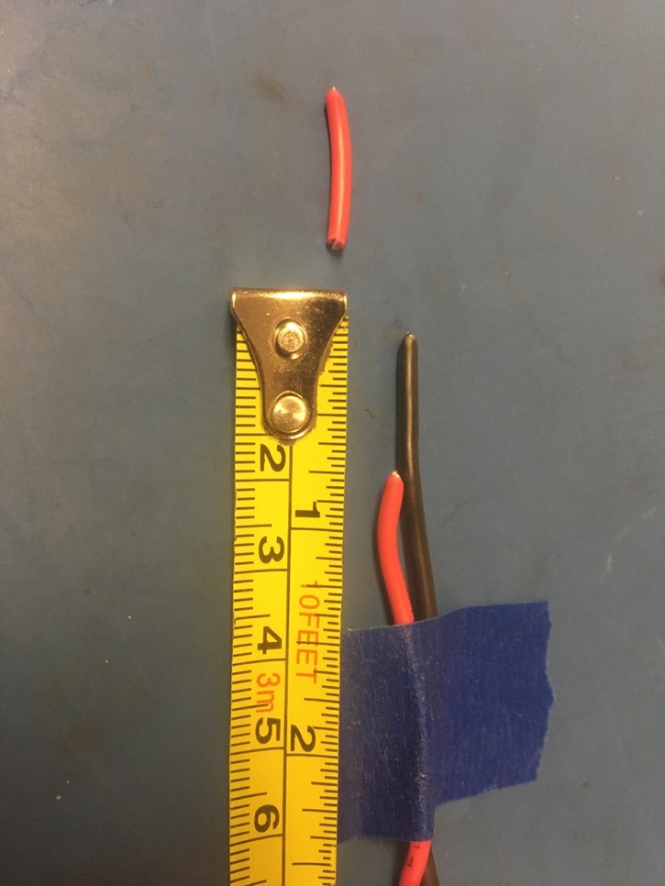
Measure the lengths of wires and trim them to be 3 inches long. Then cut the red wire so that it is .75in shorter than the black wire.

Slide 32
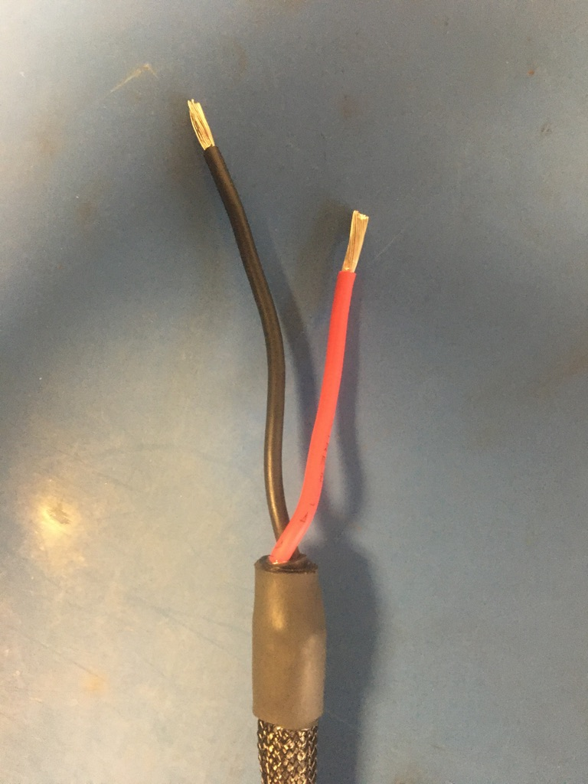
Taking the two ends of wire that were just trimmed, strip about blah mm of isolation off.

Slide 33
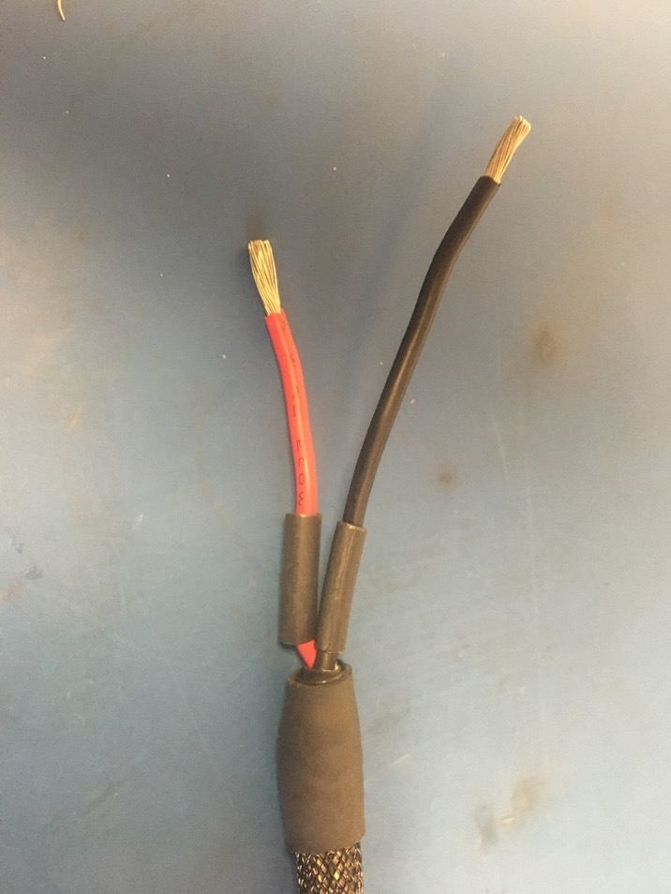
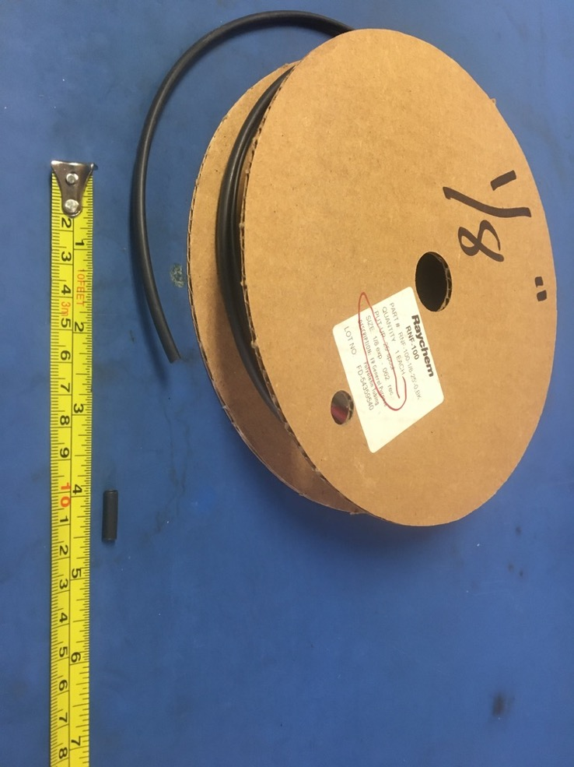
Measure out and cut two lengths of 1/8th non-adhesive shrink tube that are each .5in long. Put one length of shrink onto each of the stripped wire ends.

Slide 34
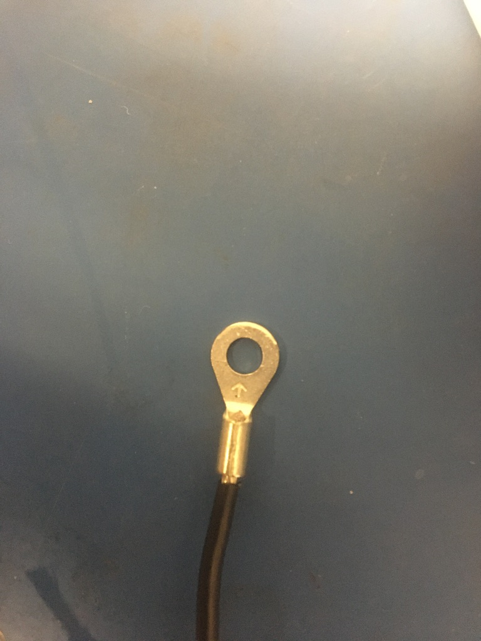
Place the size 8 eyes onto each of the stripped wire ends as shown.

Slide 35



Crimp the eyes using the 18-14 awg slot in the crimper. Each eye needs to crimped twice: one above the other as shown in the middle photo.

Slide 36


Solder the crimped joints of the eyes. The solder should cover all the exposed wire. Try to be fast as the shrink tube will shrink in the incorrect place if the heat travels too far down the wire.

Slide 37

Move the pieces of shrink tube on the wire to cover the crimped/soldered joints. Apply the heat gun.

Slide 38

Wire harness complete! The ground wire will be given a tip later.

